Slide 1
Financial Aid
Shelby Hill
She/Her/Ella
Assistant Director of Financial Aid Scholarships & Outreach
1st Generation College Graduate

Slide 2
Agenda
1 | 2 | 3 | 4 | 5 | 6
Financial Aid Basics | Federal Student Aid & the FAFSA | State Aid | Institutional Aid | Private Aid | Aid from Employers

Slide 3
What is Financial Aid?
Financial aid consists of funds provided to students and families to help pay for postsecondary educational expenses
Gift Aid
Self-Help Aid
Work-Study
Employment
Loans
Grants
Scholarships

Slide 4
Sources of Financial Aid
Federal
Employers
State
Private
Institutional

Slide 5
Federal
Largest source of financial aid
Aid provided primarily based on financial need
Must apply each year using the FAFSA
Eligibility requirements must be met

Slide 6
Cost of Attendance (COA)
Tuition and fees
Housing and food
Books and supplies
Transportation
Miscellaneous and personal

Slide 7
Student Aid Index (SAI)
Student contribution
Number resulting from the evaluation of a student’s (and family’s) approximate financial resources for a student’s postsecondary education
Parent contribution
(for dependent students)

Slide 8
Determining Financial Need
Cost of attendance (COA) – Student aid index (SAI) = Financial need

Slide 9
December 2023 availability date | March 1st priority deadline for some state aid programs | Contributors should create FSA ID & password now by visiting studentaid.gov | Collects demographic and financial information used to calculate the Student Aid Index (SAI) | Institutions and scholarship organizations use SAI to determine eligibility for aid | 2022 tax data will be used to complete the 2024-2025 FAFSA

Slide 10
Contributors
Single Parent
Student
Parent
Married Biological/Adoptive Parents
Parent 1
Parent 2
Student
Remarried Parent
Biological/Adoptive Parent
Step-Parent
Student
Parent(s) who provide the most financial support
complete the FAFSA.

Slide 11
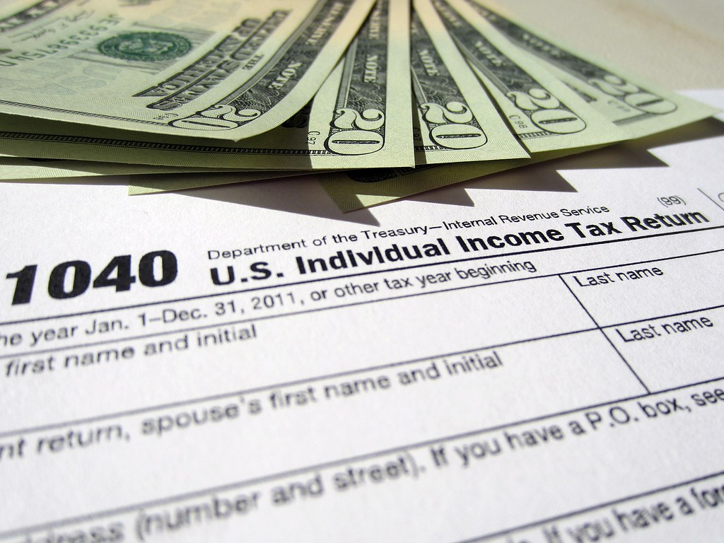
FUTURE Act Direct Data Exchange (FA-DDX)
Allows for an individual’s federal tax information (FTI) to be directly transferred from the IRS to the FAFSA
Consent is required by all contributors on FAFSA
IRS transfers information to populate FAFSA income questions for most tax filers

Slide 12
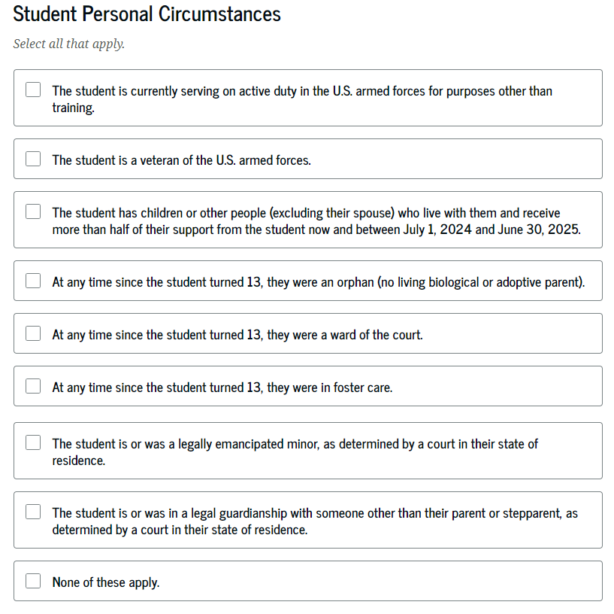
Determining Dependency Status

Slide 13
Special Circumstances
Unusual uncovered medical/dental expenses
Secondary school tuition
Extraordinary dependent care
Parent or spouse death
Loss of employment or income
Divorce

Slide 14
Unusual Circumstances
Orphaned at age 13 or older
Emancipated Minor / Legal Guardianship
Foster Care
Incarceration

Slide 15
What Happens Next?
Schools you listed on your FAFSA will receive your FAFSA information
Look for communications from those institutions
Follow-up with the financial aid office
Review financial aid page of institution’s website
Know the deadlines for each institution

Slide 16
FAFSA Timeline
2024-2025
Now
Create FSA IDs
December
?
Submit the FAFSA
Late January
FAFSA data available to schools
FAFSA Submission Summary available to students
Keep in Mind:
Maryland’s Priority Deadline is March 1st
Schools will have priority deadlines

Slide 17
FAFSA Timeline
Future Academic Years Beyond 2024-2025
Prior to Oct.1
Create FSA IDs
Oct.
1
Submit the FAFSA
After FAFSA is submitted
FAFSA data available to schools
FAFSA Submission Summary available to students
Keep in Mind:
Maryland’s Priority Deadline is March 1st
Schools will have priority deadlines

Slide 18
Borrowing Student Loans
Students must be enrolled at least half-time (six or more required credits) in an eligible program to borrow federal student loans
There are annual loan limits
Parent PLUS Loans – credit-based
Loans must be repaid with interest
Different types of loans (subsidized vs. unsubsidized)
Borrow responsibly
Loan Simulator
Loan forgiveness is not promised!

Slide 19
Did you know?
Students must comply with different policies to maintain eligibility for aid. Examples include:​
Satisfactory Academic Progress (SAP)​
Specific GPA & Completion Rate ​
Return to Title IV (R2T4)​
Aid can be returned if deemed unearned​
Attendance​
Must be verified for Federal Student Aid (FSA) eligibility ​
Courses Not Used (CNU)
Students may only receive certain types of aid for courses required of their degree program

Slide 20
State Aid
Maryland Higher Education Commission (MHEC)
Residency requirements apply
Aid provided based on both merit and need
Information from FAFSA, MSFAA, or MD One App is used to determine eligibility
Maryland’s priority deadline is March 1st
Must include at least one MD school on the FAFSA to be considered for state aid

Slide 21
Maryland State Financial Aid
mhec.state.md.us
ALL students should create an MDCAPS account – this is where you go to accept state aid!
Students only have six weeks to accept state aid
MHEC may request the student upload documents to the MDCAPS portal
Add donotreply@maryland.gov to your email contacts
Very few exceptions for receiving state aid at an out-of-state school
----------------

Slide 22
Maryland State Financial Aid
mhec.state.md.us

Slide 23
Maryland State Financial Aid Application
(MSFAA)
Available for students who are undocumented and meet certain eligibility criteria | Determines eligibility for state financial aid | March 1st is the priority deadline for most State financial aid programs | There may be additional steps you must complete in MDCAPS after submitting the MSFAA. | The Financial Aid Office is available to assist you if you need help with the MSFAA!

Slide 24
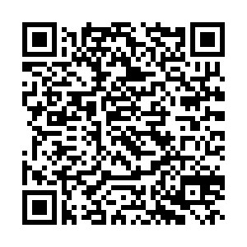
Maryland Community College Promise Scholarship
Up to $5,000 per academic year for households earning between $100,000-$150,000 during 2022 tax year ​
Must complete high school/earn GED in Maryland​
2.3 cumulative high school GPA required*​
Available for credit and non-credit programs​
Minimum of six credits per semester required for credit programs
Must be eligible for in-state tuition and fee rate​
Must include a community college on the FAFSA
​
*unless student graduated high school five or more years ago OR student earned a GED.
---------------------

Slide 25
Legislative Scholarships
Contact your State Senator & State Delegate www.mdelect.net | Applications may be submitted in February & awards are typically made by May. | Need-based & non-need-based opportunities are available!

Slide 26
Institutional
Aid provided based on both merit and financial need
Aid may be gift aid or self-help aid
Use information from the FAFSA and/or institutional applications
Deadlines and application requirements vary by institution

Slide 27
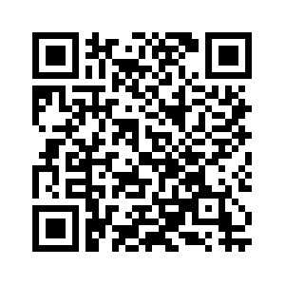
FCC Foundation Scholarships
Fall: February 1st – June 15th
Spring: October 1st – December 31st
Summer scholarships may be available – inquire with the FCC Foundation in early May.
Apply online:
https://www.frederick.edu/foundation/scholarships.aspx

Slide 28
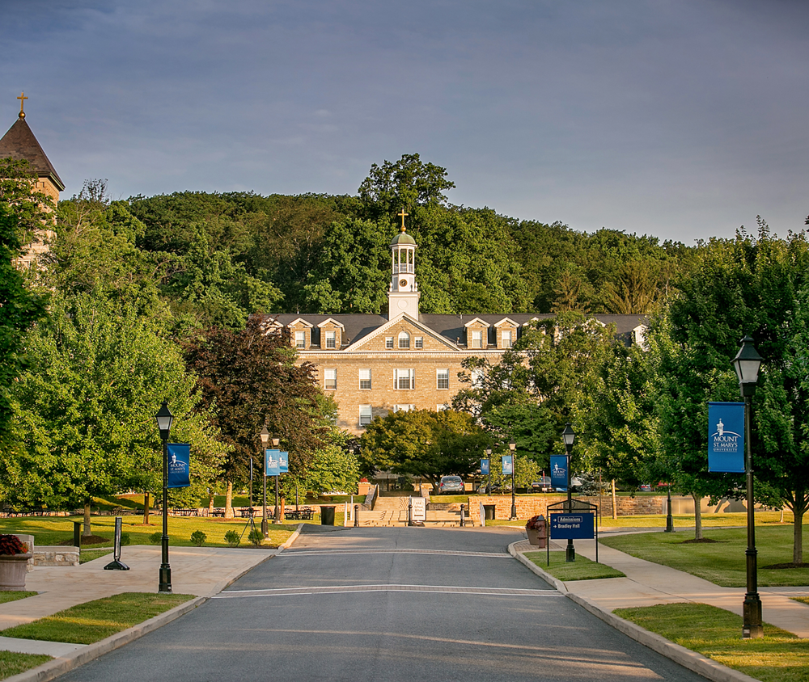
Mount St. Mary’s University
Merit Scholarship Awards
Trustee Scholarship - $31,000
Presidential Scholarship - $29,000
Provost’s Scholarship - $27,000
Dean’s Scholarship - $26,000
University Scholarship - $22,000

Slide 29
Mount St. Mary’s University
Live Significantly Opportunity Grant
Full tuition, fees, room, and meals for students who qualify for the MD State Howard P. Rawlings Guaranteed Access Grant.
For more information contact the Financial Aid Office at Mount St. Mary’s University!
(301) 447-5207
finaid@msmary.edu

Slide 30
Private
Foundations, businesses, churches, civic, and charitable organizations
Deadlines and applications procedures vary
Begin researching private sources early

Slide 31
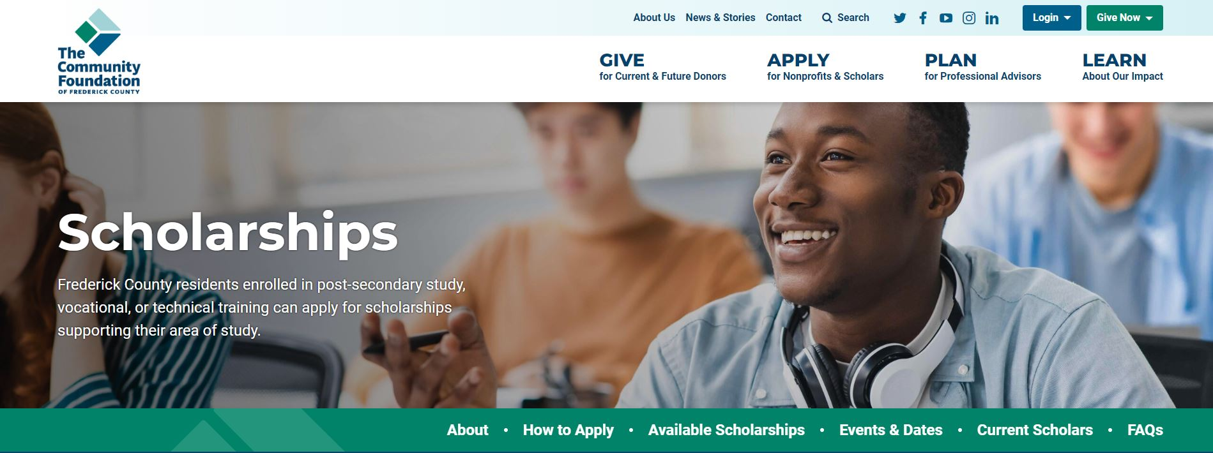
$2.2 million awarded to Frederick County students in 2022!
https://www.frederickcountygives.org/
Application is available online from 2/15-3/15/2024

Slide 32
External Scholarship Searches

Slide 33
Employers
May have scholarships available for the children of employees
The student’s employer may offer
educational benefits

Slide 34
Continuing Education & Workforce Development
There are financial aid opportunities available for students wishing to pursue CEWD programs!
Continuing Education & Workforce Development – direct link to view CEWD programs
Financial Assistance Request Form - complete this form if you are interested in a CEWD program & a College representative will contact you to go over opportunities you may be eligible for!
Examples of opportunities:
State: Maryland Promise & Workforce Development Sequence Scholarship
Institutional: scholarships offered for CEWD students from the FCC Foundation

Slide 35
Recommendations from the Financial Aid Office
Stay Engaged
Apply for as many scholarships as possible
Avoid Student Loan Debt
Have an understanding of the requirements of any aid you are offered
Ask Questions…
lots of ‘em!
Start the process early

Slide 36
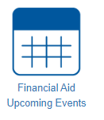
Join us for FAFSA Finish Workshops!
Date | Time | Location
Monday, January 8, 2024 | 6:00pm-8:00pm | Urbana High
Tuesday, January 9, 2024 | 6:00pm-8:00pm | Catoctin High
Wednesday, January 10, 2024 | 6:00pm-8:00pm | Oakdale High
Thursday, January 11, 2024 | 6:00pm-8:00pm | Tuscarora High
Wednesday, January 17, 2024 | 6:00pm-8:00pm | Middletown High
Thursday, January 18, 2024 | 6:00pm-7:30pm | Brunswick High
Thursday, February 8, 2024 | 6:00pm-8:00pm | Gov. Thomas Johnson High
Saturday, February 10, 2024 | 10:am-2:00pm | FCC
Monday, February 12, 2024 | 5:00pm-7:00pm | Walkersville High
Tuesday, February 13, 2024 | 6:00pm-8:00pm | Frederick High
Thursday, February 15, 2024 | 6:00pm-8:00pm | Linganore High
Links to register will be available here!

Slide 37
FCC Financial Aid Office
Jefferson Hall, 3rd Floor
financialaid@frederick.edu
(301) 846-2620 (option 1)
Monday: 8:30 a.m. - 6:00 p.m. Tuesday-Friday*: 8:30 a.m. - 4:30 p.m. *Thursday hours: Open until 6:00 p.m. (January, July, August)
No appointment necessary!

Slide 38
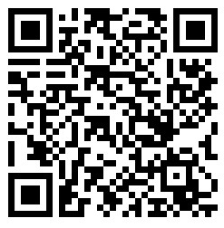
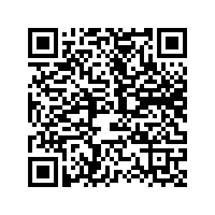
Thanks for Coming!
Download
Slideshow Here
Provide Feedback Here

