Slide 1
2024-2025 Scholarship Programs
Sonia Tineo - Community Impact Associate
Diana Fulchiron – Community Impact Director
Shanté Frazier – Community Impact Manager
February 2024
www.FrederickCountyGives.org

Slide 2
What is The Community Foundation of Frederick County?
A nonprofit, philanthropic organization
Provides scholarships to students and grants to area nonprofits
Builds a stronger, more vibrant community
Creates positive and lasting impact

Slide 3
2023-2024 Scholarship Programs:
General and Career Education

Slide 4
411 students received scholarships
2023-2024 Scholarship Programs
1,400+ applications received
523 scholarships provided
191 high school seniors received scholarships
220 students already enrolled in college received scholarships

Slide 5
General Scholarship
Eligibility Details

Slide 6
Scholarships are primarily for Frederick County residents
Who qualifies?

Slide 7
Open to any area of study Apply at any point in your academic career

Slide 8
What kinds of programs are eligible?
Technical certifications and career training
2- and 4- year degree programs
Graduate and post-graduate studies
Studying part-time or full-time

Slide 9
What can scholarships be used for?
Minimum Scholarship: $1,000
May be used for tuition, room, board, books, and fees

Slide 10
Do I need to prove financial need to qualify?

Slide 11
General Scholarship
Application Details

Slide 12
Apply at: ScholarshipsFrederickCounty.com
Application opens February 15, 2024
Deadline is April 15, 2024
Late applications will not be considered

Slide 13
Fill out one application
Gain access to 200+ scholarship opportunities

Slide 14
APPLICATION
ScholarshipsFrederickCounty.com
Online application
Do NOT use your FCPS email to create an account
Foundation staff cannot reset your password
Foundation staff can access your username

Slide 15
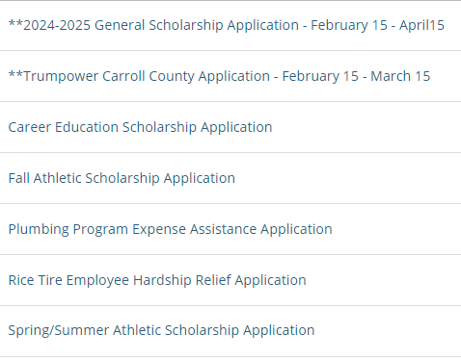
APPLICATION
Please select the correct scholarship application to complete

Slide 16
RENEWALABLE SCHOLARSHIPS
You MUST submit a new application every year
You MUST use the same user account to apply
You MUST maintain any qualifying criteria
Some scholarships can be awarded multiple years in a row

Slide 17
PREPARE YOUR APPLICATION

Slide 18
Organize your information
Lists of activities
Volunteer
Employment
Sports
Clubs
Membership Organizations
Church

Slide 19
Write your personal essay
Write a response to one of the 7 Common App prompts
Have a trusted friend, parent, or advisor proofread it

Slide 20
How long will the application take?
With your documents in hand and essays pre-written, the online application should take about an hour
Some scholarships include specific criteria and may require additional short essays or other uploaded materials

Slide 21
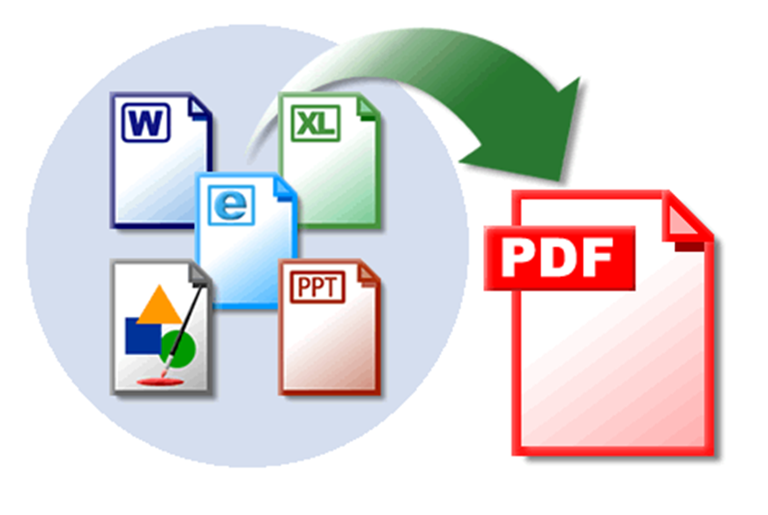
Gather electronic documents
Request a PDF of your transcript or scan multiple transcripts into a single PDF
Download your FAFSA Submission Summary report into a second PDF

Slide 22
Financial-need based applications must include:
FAFSA Summary Submission PDF or completion page of the MSFAA
Short essay on your financial needs

Slide 23
How do I get a FAFSA Submission Summary? Fill out…

Slide 24
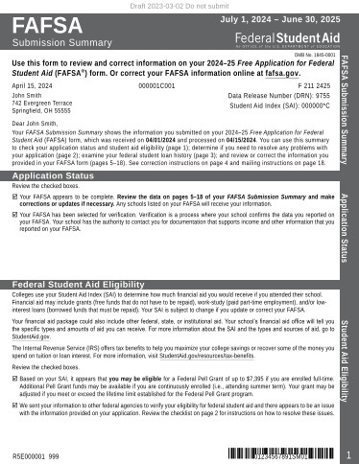
Student Aid Index

Slide 25
How do I apply for MSFAA? Fill out…
mdcaps.mhec.state.md.us

Slide 26
Help with FAFSA or MSFAA
FAFSA Finish Workshops
Register here:
https://secure.acceptiva.com/?cst=YLYZch
Multiple workshops available. Register for the event that works for you and your family.

Slide 27
KEY DATES
Apply February 15 to April 15, 2024
Scholarship announcements will start at the beginning of May and will be sent via email
Emails will be sent from an @ngwebsolutions.com address

Slide 28
Career Education Scholarship Details

Slide 29
Students can apply any time before May 1, 2024
Applications are reviewed as they are received for as long as funding remains
Scholarships can cover tuition, certifications, exam fees, purchase of tools or supplies
Career Education Scholarships

Slide 30
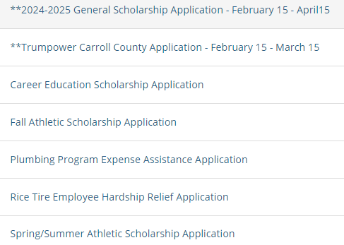
APPLICATION
ScholarshipsFrederickCounty.com
Please select the correct scholarship application to complete

Slide 31
Stay Connected – We’re Social!

Slide 32
Questions?
Diana Fulchiron, Director of Community Impact
d.fulchiron@FrederickCountyGives.org
Sonia Tineo, Communication Impact Assoc
s.tineo@FrederickCountyGives.org
Shanté Frazier, Community Impact Manager
s.frazier@FrederickCountyGives.org

